Slide 1
It’s assembler, Jim, but not as we know it!
Morgan Gangwere
DEF CON 26
Notes:
Hello, I’m Morgan Gangwere and this is It’s assembler, Jim, but not as we know it! We’re going to be looking at some fun shenanigans you can have with embedded devices running Linux (and other things)

Slide 2
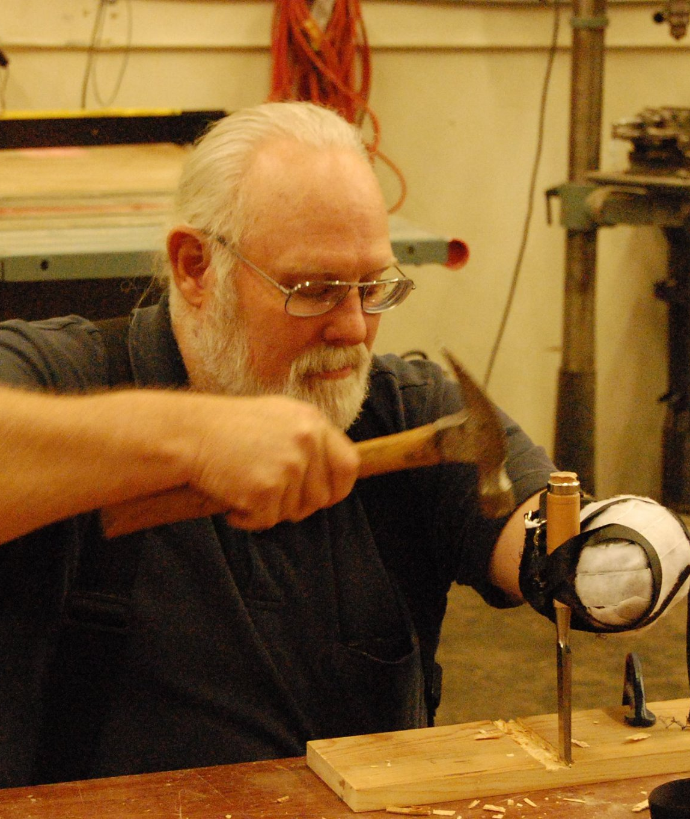
Dedication
Never forget the shoulders you stand on.
Thanks, Dad
Notes:
First a shout-out to my father. He’s an awesome man who taught me the importance of understanding tools and then making your own. This is him using a chisel with just one hand – and a tool.

Slide 3
whoami
Hoopy Frood
Been fiddling with Linux SOCs since I fiddled with an old TS-7200 EmbeddedARM board
I’ve used ARM for a lot of services: IRC, web hosting, etc.
I’ve built CyanogenMod/LineageOS, custom ARM images, etc.
Notes:
So who am I?
I’m the hoopiest frood that ever did cross the galaxy, been doing Linux-y stuff since I was a wee lad making off with one of my father’s dev kits, and I’ve built my own tools for some time.

Slide 4
A word of note
There are few concrete examples in this talk. I’m sorry.
This sort of work is
One part science
One part estimation
Dash of bitter feelings towards others
Hint of “What the fuck was that EE thinking?”
A lot comes from experience. I can point the way, but I cannot tell the future.
There’s a lot of seemingly random things. Trust me, It’ll make sense.

Slide 5
ARMed to the teeth
From the BBC to your home.
Notes:
So let’s talk about ARM.

Slide 6
Short history of ARM
Originally the Acorn RISC machine
Built for the BBC Micro!
Acorn changed hands and became ARM Holdings
Acorn/ARM has never cut silicon!
Fun fact: Intel has produced ARM-based chips (StrongARM and XSCale) and still sometimes does!
The ISA hasn’t changed all that much.
Notes:
ARM, the Acorn RISC Machine, was built for the BBC Micro in 1985 by Acorn Computer, predominantly designed by the hands of Sophie Wilson. Later, ARM was changed to Advanced RISC machine, and later into simply ARM. The ARM ISA has stayed the same since ARM2.. Mostly. There’s been changes to keep up with the time, but you could read ARM assembler from the 80s and understand it today.

Slide 7
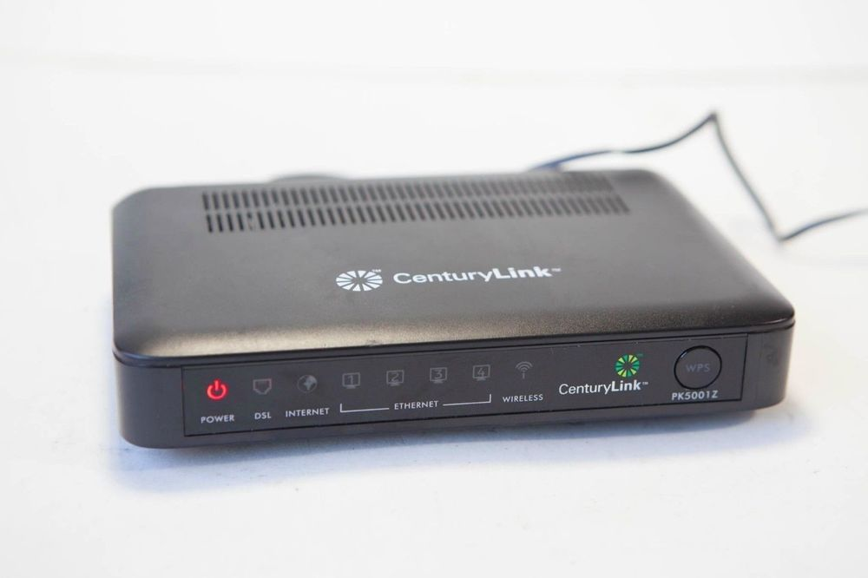
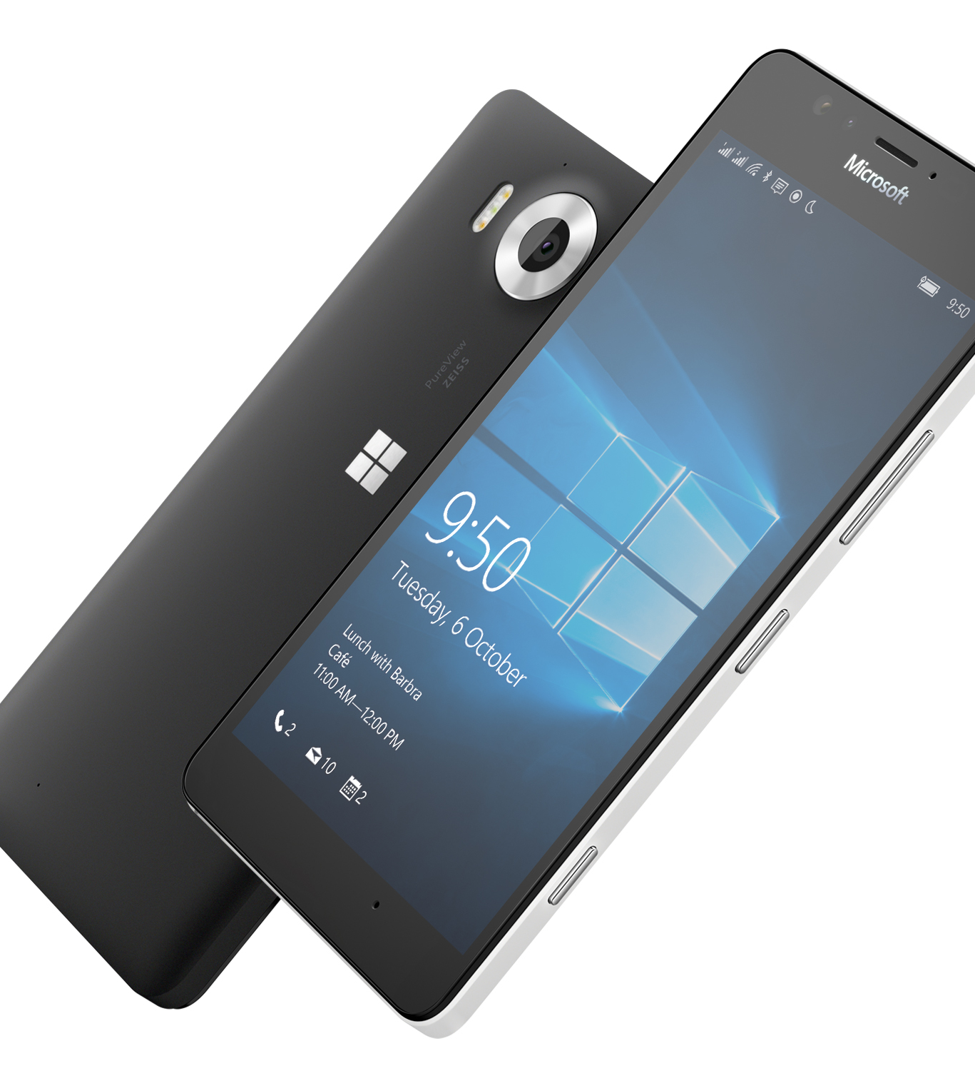
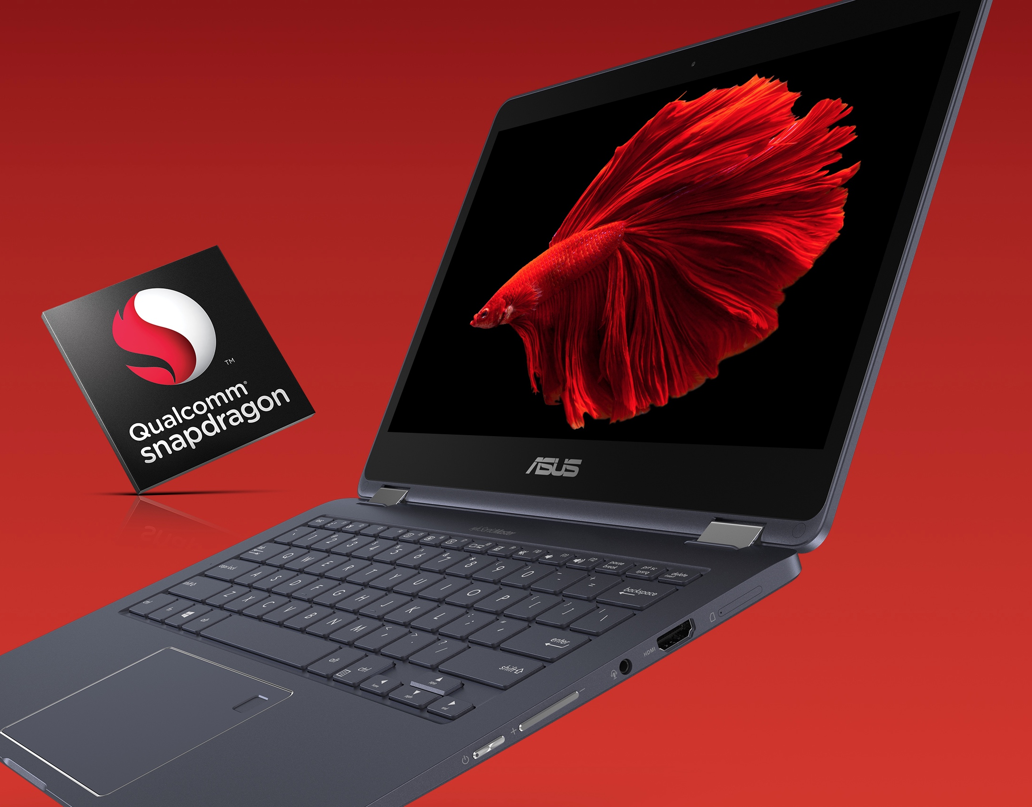
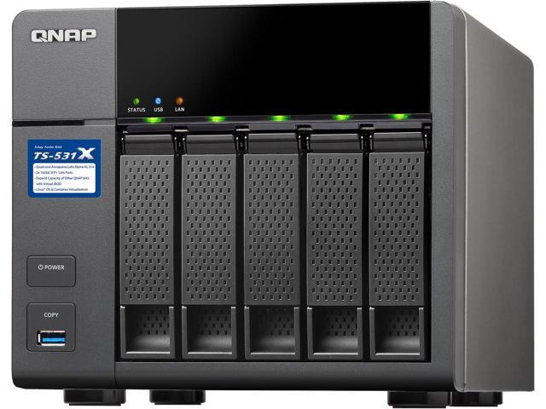
Notes:
Network appliances, phones and routers have been running on top of ARM for quite a while: It’s cheap, low power and versatile enough to do what most people want it to do. These small linux-based ARM devices have become fixtures in our houses and in enterprise. We’re now seeing ARM-based laptops, with ASUS’ NovaGo coming to market and several other devices based on Qualcomm’s Snapdragon processor line running full desktop OS’s on them and getting days of battery life.

Slide 8
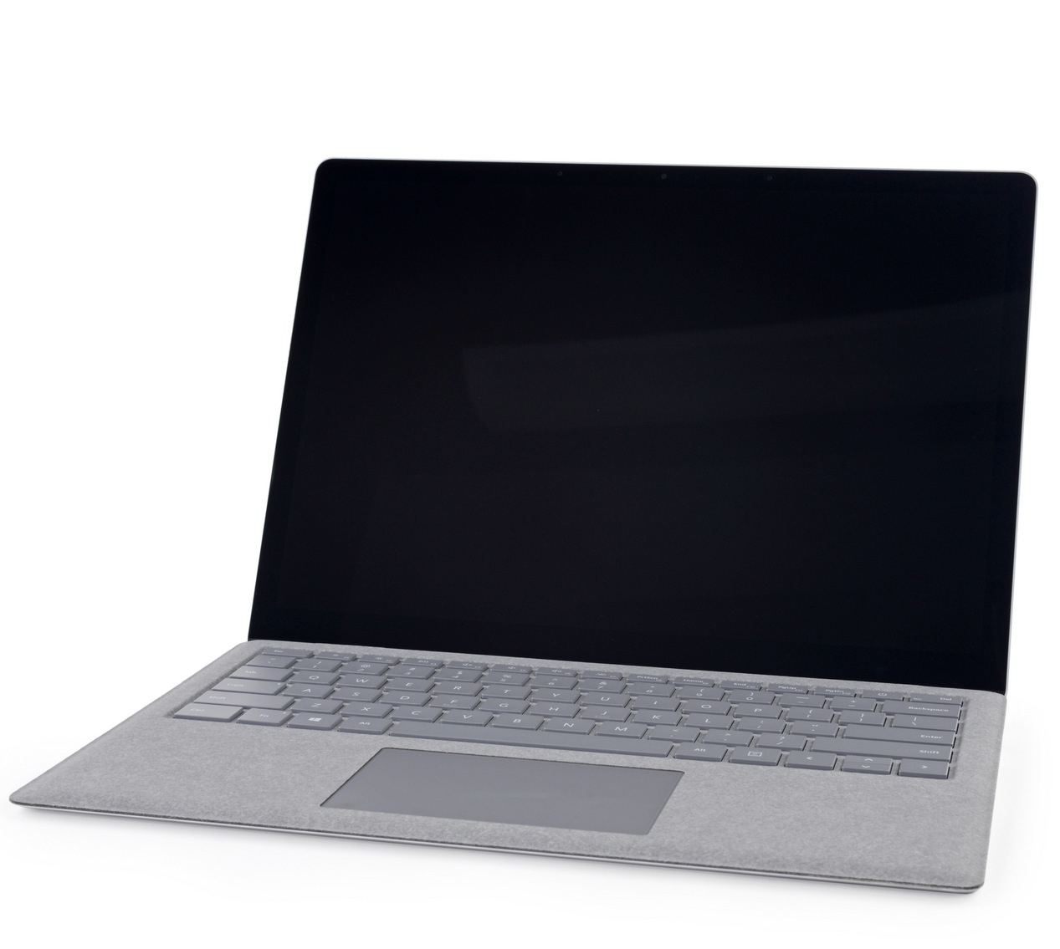
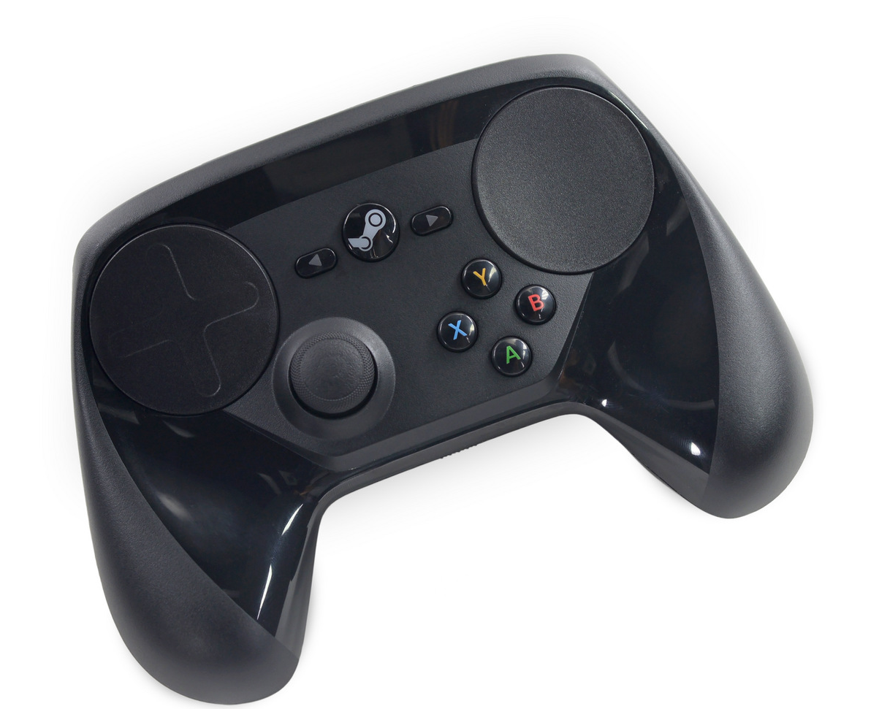
Notes:
The whole line of IKEA’s TRADFRI Smart LED lighting solutions run on ARM Cortex M0 chips, including the dimmers and bulbs. They go for months on a CR2032 battery.

Slide 9
Embedded Linux 101
Notes:
So let’s talk about Embedded Linux devices in general.

Slide 10
Anatomy of an Embedded Linux device.
Fundamentally 3 parts
Storage
SoC/Processor
RAM
Everything else? Bonus.
PHYs on everything from I2C, USB to SDIO
Cameras and Screens are via MIPI-defined protocols, CSI and DSI respectively
At one point, they all look mostly the same.
Notes:
Embedded Linux devices consist of three general parts: An SoC, Storage, and RAM. Most everything else is just a peripheral of some kind, like displays, USB devices, SDIO and more.

Slide 11
What is an SoC?
Several major vendors:
Allwinner, Rockchip (China)
Atheros, TI, Apple (US)
Samsung (Korea)
80-100% of the peripherals and possibly storage is right there on die
Becomes a “just add peripherals” design
Some vendors include SoCs as a part of other devices, such as TI's line of DSPs with an ARM SoC used for video production hardware and the like.
In some devices, there may be multiple SoCs: A whole line of Cisco-owned Linux-based teleconferencing hardware has big banks of SoCs from TI doing video processing on the fly alongside a DSP.
Notes:
For those not familiar, an SoC, or System on Chip, is a “Just Add Peripherals” building-block in the design of devices. There’s an SoC in your smartphone, for instance, that handles most of your phone’s peripherals, including radios and display adapters. There’s a handful of major players in the field, including several in the US, China, and Korea. SoCs are often bundled with application-specific silicon, such as a whole line of TI DSP chips which have an ARM SoC on-die to control it, complete with Ethernet PHY and a little bit of RAM.

Slide 12
What is an SoC?
Internal bus
Peripheral Controller
LTE modem
GPU
CPU Core(s)
Ethernet PHY
I2C/SPI
RAM (sometimes)
External Peripherals
Storage Controller
SD Card/NAND/etc
Notes:
All the different SoC designs look astoundingly similar, so here’s a really generic look at it. Everything rides on an internal bus of some kind, with peripherals sitting on some kind of controller. There’s sometimes a secondary storage controller to make external storage such as SATA, NAND, or other storage technologies available early on or through some kind of abstraction layer.

Slide 13
Notes:
Once you’ve seen one

Slide 14
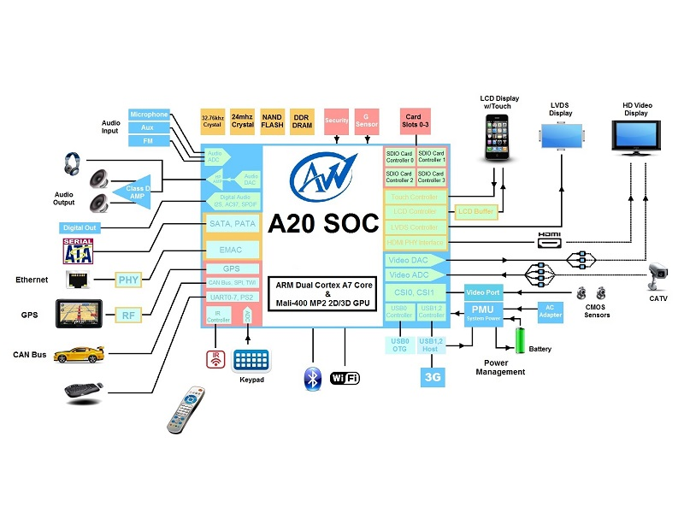
Notes:
You’ve seen them all

Slide 15
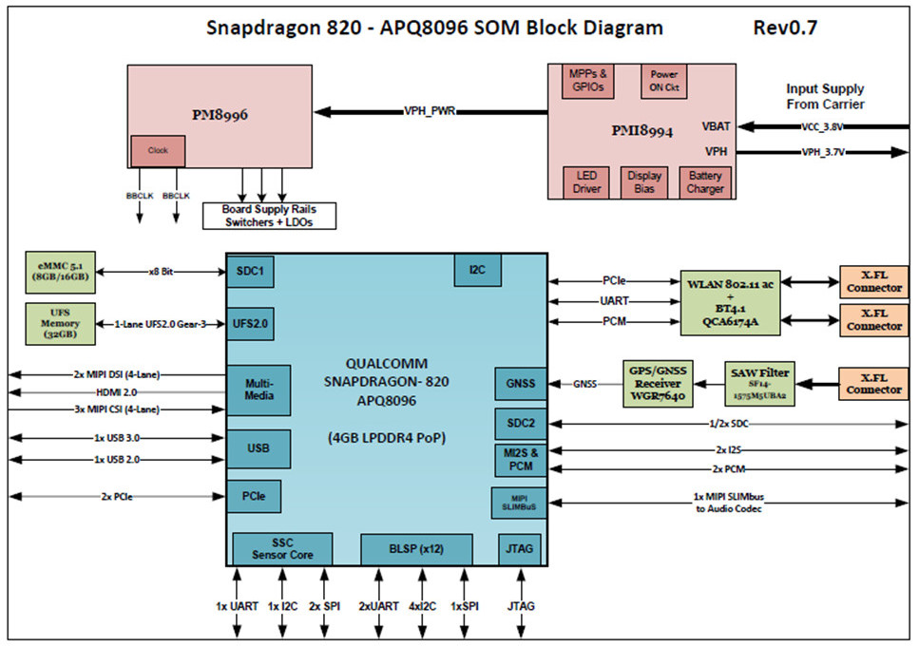
Notes:
They only really differ in the specific features: Here we see that this Snapdragon has 4G of LPDDR4 stacked on top, but also has 2 PCIe lanes!

Slide 16
Notes:
Even Intel makes SoCs! This is a Bay Trail SoC – I suspect similar to what’s in the MinnowBoard or something similar. As you can see, it even includes Legacy component support, such as SMBUS!

Slide 17
Storage
Two/Three common flavors
MTD (Memory Technology Device): Abstraction of flash pages to partitions
Notes:
Storage is another story entirely. The first type of storage is MTD, or Memory Technology Device. This is NAND Flash at its core, and it gets abstracted out later by both the bootloader and Linux itself.

Slide 18
Storage
Two/Three common flavors
MTD (Memory Technology Device): Abstraction of flash pages to partitions
eMMC: Embedded MultiMedia Card
Notes:
Then we have the venerable eMMC, which are a form of the now oldschool MMC, or MultiMedia Card, specifications.

Slide 19
Storage
Two/Three common flavors
MTD (Memory Technology Device): Abstraction of flash pages to partitions
eMMC: Embedded MultiMedia Card, SPI SD card
SD cards
Notes:
And now we have SD cards. Secure Digital has seen a few revisions of the form factor over time, but the protocol has stayed mostly the same. SD cards are almost 1:1 compatible with MMC cards and eMMC in a legacy, 4-bit mode that was used in The Old Days.

Slide 20
Storage
Two/Three common flavors
MTD (Memory Technology Device): Abstraction of flash pages to partitions
eMMC: Embedded MultiMedia Card, SPI SD card
SD cards
Jackpot!
Notes:
However, seeing an exposed SD card is rare, but is a real jackpot opportunity. For example, the first generation Kindle uses it, but so does the Raspberry Pi.

Slide 21
Storage
Two/Three common flavors
MTD (Memory Technology Device): Abstraction of flash pages to partitions
eMMC: Embedded MultiMedia Card, SPI SD card
SD cards
Then there’s UFS
Introduced in 2011 for phones, cameras: High Bandwidth storage devices
Uses a SCSI model, not eMMC’s linear model
Notes:
UFS is a new standard, somewhat common now in phones, for storing things. It’s fast – Gigabits per second fast – and could very well become a standard for more devices in the future. It’s also much more compatible with the classic SCSI way of looking at disks, which makes it ideal for things like Windows.

Slide 22
Variations
Some devices have a small amount of onboard Flash for the bootloader
Commonly seen on phones, for the purposes of boostrapping everything else
Every vendor has different tools for pushing bits to a device and they all suck.
Samsung has at least three for Android
Allwinner based devices can be placed into FEL boot mode
Fastboot on Android devices
Notes:
There’s some mix-and-match when it comes to storage though. There’s often at least some baked-in flash that handles loading the bootloader, called the IPL, which is useful for bootstrapping everything else when push comes to shove. Every vendor has their own shitty way of cramming data onto the boot storage of the device, and they’re all pretty bad.

Slide 23
RAM
The art of cramming a lot in a small place
Vendors are seriously tight-assed
Can you cram everything in 8MB? Some routers do.
The WRT54G had 8M of RAM, later 4M
Modern SoCs tend towards 1GB, phones 4-6G
In pure flash storage, ramfs might be used to expand on-demand files (http content)
Notes:
Let’s talk about RAM.
Sometimes, you get a lot of RAM – some phones are pushing 8 gigabytes of RAM just to hold Android. On the other hand, the WRT54G and a whole host of newer devices ship with 8MB of RAM. Talk about tight-assed.

Slide 24
Peripherals
Depends on what the hardware has: SPI, I2C, I2S, etc are common sights.
Gonna see some weird shit
SDIO wireless cards
“sound cards” over I2S
GSM modems are really just pretending to be Hayes AT modems.
Power management, LED management, cameras, etc.
“We need an Ethernet PHY” becomes “We hooked an Ethernet PHY up over USB”
Linux doesn’t care if they’re on-die or not, it’s all the same bus.
Notes:
Now, on to peripherals. If your target application talks with these, you’re going to get nice and cozy with wiggling electrons.
This ultimately depends on what the SoC provides, which is a function of what the specific application needs. SPI, I2C and such are common. However, this hasn’t stopped some astoundingly dumb choices or seemingly weird choices.

Slide 25
Peripherals
Depends on what the hardware has: SPI, I2C, I2S, etc are common sights.
Gonna see some weird shit
SDIO wireless cards
“sound cards” over I2S
GSM modems are really just pretending to be Hayes AT modems.
Power management, LED management, cameras, etc.
“We need an Ethernet PHY” becomes “We hooked an Ethernet PHY up over USB”
Linux doesn’t care if they’re on-die or not, it’s all the same bus.
Notes:
Remember that Snapdragon 820? It uses a PCIe lane, a UART and PCM channel to do WLAN and Bluetooth. Instead of cramming everything onto the PCIe lane, they chose to make it so that Bluetooth output and input are just lines on the internal audio codec.

Slide 26
Peripherals
Depends on what the hardware has: SPI, I2C, I2S, etc are common sights.
Gonna see some weird shit
SDIO wireless cards
“sound cards” over I2S
GSM modems are really just pretending to be Hayes AT modems.
Power management, LED management, cameras, etc.
“We need an Ethernet PHY” becomes “We hooked an Ethernet PHY up over USB”
Linux doesn’t care if they’re on-die or not, it’s all the same bus.
Notes:
So many devices are going to be weird as fuck though. GSM modems for example are just Hayes AT modems with some extra glue.

Slide 27
Peripherals
GPIO
Depends on what the hardware has: SPI, I2C, I2S, etc are common sights.
Gonna see some weird shit
SDIO wireless cards
“sound cards” over I2S
GSM modems are really just pretending to be Hayes AT modems.
Power management, LED management, cameras, etc.
“We need an Ethernet PHY” becomes “We hooked an Ethernet PHY up over USB”
Linux doesn’t care if they’re on-die or not, it’s all the same bus.
Not GPIO!
Notes:
Sometimes, all the fancy LEDs on your device aren’t GPIO pins on the SoC. Instead, they’re an external peripheral. This is a Nextbit Robin, where the flash LED is a part of the camera hardware and the LEDs on the back are actually controlled by a TI LED controller that has its own tiny ISA.

Slide 28
Bootloader
One Bootloader To Rule Them All: Das U-Boot
Uses a simple scripting language
Can pull from TFTP, HTTP, etc.
Might be over Telnet, Serial, BT UART, etc.
Some don’t use U-Boot, use Fastboot or other loaders
Android devices are a clusterfuck of options
Notes:
Without the bootloader, you’d be nowhere, though. U-Boot is by far the most common bootloader for embedded devices, with routers and the like being the most common users. Phones and such are a whole different show, with a whole variety of options kicking around. Chances are, however, if it’s not a phone it probably uses U-Boot.

Slide 29
Life and death of an SoC*
* Some restrictions apply
IPL
Load Kernel into RAM
Start kernel
Userland
Kernel has to wake up (or re-wake) devices it wants. It can’t make any guarantees.
Bootloader
Early UART/network wakeup is likely here.
Does signature checking of early boot image
Probably SoC vendor provided
Some devices are dumb and load multiple kernels until one fails or they run out
U-Boot is really running a script here.
Home of the party.
Where the fun attacks are
DFU Check
First chance to load fresh code onto device, use for bootstrapping and recovery
Notes:
The bootloader’s job comes right after the IPL: Its job is to wake up any devices that haven’t been as needed such as storage, load the kernel into memory, and kick it off. We’ve seen this dance before. This, as it turns out, is a whole lot cleaner on ARM than it is on Intel’s clusterfuck of a design.

Slide 30
Life and death of an SoC*
* Some restrictions apply
Early Boot
Load Kernel into RAM
Start kernel
Userland
Kernel has to wake up (or re-wake) devices it wants. It can’t make any guarantees.
U-Boot
Early UART/network wakeup is likely here.
Does signature checking of early boot image
Probably SoC vendor provided
Some devices are dumb and load multiple kernels until one fails or they run out
U-Boot is really running a script here.
Home of the party.
Where the fun attacks are
DFU Check
First chance to load fresh code onto device, use for bootstrapping and recovery
The Fun Shit
Notes:
The real fun is when you can attack the earliest part of the boot sequence, the DFU or Device Firmware Update sequence. DFU mode is how fresh code is loaded on without any consent from the higher levels of the environment. This is also the place that most – if not every – OEM puts the most time into: Keeping someone else from fixing their problems becomes a steady stream of new devices. U-Boot and the userland are the other two fun parts of this, for the obvious reasons.

Slide 31
Root Filesystem: Home to All
A root filesystem contains the bare minimum to boot Linux: Any shared object libraries, binaries, or other content that is necessary for what that device is going to do
Fluid content that needs to be changed or which is going to be fetched regularly is often stored on a Ramdisk; this might be loaded during init's early startup from a tarball.
This is a super common thing to miss because it's a tmpfs outside of /tmp
this is a super common way of keeping / “small”
This often leads to rootfs extractions via tar that seem "too big“
There are sometimes multiple root filesystems overlaid upon each other
Android uses this to some extent: /system is where many things really are
Might be from NFS, might try NFS first, etc.
Notes:
A device with no code to run is a device without a purpose. We need a root filesystem. Sometimes you get several, overlaid upon one another. Android does this and so does your LiveCD.

Slide 32
Attacking these devices
Notes:
So how do we go about attacking these sorts of devices?

Slide 33
Step 0: Scope out your device
Get to know what makes the device tick
Version of Linux
Rough software stack
Known vulnerabilities
Debug shells, backdoors, admin shells, etc.
ARM executables are fairly generic
Kobo updates are very, VERY generic and the Kobo userland is very aware of this.
Hardware vendors are lazy: many devices likely similar to kin-devices
Possibly able to find update for similar device by same OEM
Notes:
Always. Always start with step 0: Get to know the device. Figure out what makes it go. Remember that ARM executables are really generic, and this is used by many vendors to ship the same code to different platforms. Vendors are lazy: they want to produce the most devices with the least amount of work possible.

Slide 34
Don’t Reinvent The Wheel
Since so many embedded linux devices are similar, or run similarly outdated software, you may well have some of your work cut out for you
OWASP has a whole task set devoted to IoT security:
https://www.owasp.org/index.php/OWASP_Internet_of_Things_Project
Tools like Firmwalker (https://github.com/craigz28/firmwalker) and Routersploit (https://github.com/threat9/routersploit) are already built and ready. Sometimes, thinking like a skid can save time and energy for other things, like beer!
Firmware Security blog is a great place to look, including a roundup of stuff (https://firmwaresecurity.com/2018/06/03/list-of-iot-embedded-os-firmware-tools/ )
Notes:
Don’t reinvent the wheel. Tools like Firmwalker and Routersploit, as well as the information on the OWASP IoT Security task set are meant to help streamline finding the information you need out of filesystems, updates, etc. If these sorts of things start really getting interesting, go read the roundups by the firmware Security blog.

Slide 35
Option 1: It’s a UNIX system, I know this
If you can get a shell, sometimes just beating against your target can be fun
Limited to only what is on the target (or what you can get to the target)
Can feel a bit like going into the wild with a bowie knife and a jar full of your own piss
Debugger? Fuzzer? Compiler? What are those?
Notes:
So, Option 1 is to treat it like any other UNIX system. Straight forward if you have a shell, you can start poking around. Often, however, you’re already going to have a root shell or something very close to it, as well as only a handful of tools. You’re not regularly going to get a debugger, compiler, even manpages. These devices are stripped to the bone.

Slide 36
Option 2: Black-Box it
Lots of fun once you’re used to it or live service attacks.
Safe: Never directly exposes you to “secrets” (IP)
You don’t have the bowie knife, just two jars of piss.
Notes:
Option 2 is to black box the thing. This is turns your attack into any other straightforward service attack where you have no control over the device itself.
IANAL, but it would seem that this has less likelihood of you stumbling upon something vendor-secret, such as leftover binaries not pulled from the development process. .Again, IANAL. If you think you might possibly have an inkling that you need a lawyer, get a fucking lawyer.

Slide 37
These options suck
Can Really
Notes:
These options fucking suck though.
It’s always better when you can investigate the whole goddamn binary.

Slide 38
Option 3: Reverse it
Pull out IDA/Radare
Grab a beer
Learn you a new ISA
The way of reversing IoT things that don’t run Linux!
… but how the fuck do you get the binaries?
Notes:
So the obvious answer is to reverse it. Already familiar with cracking open X86 executables in IDA? Radare? Time to learn a new ISA, grab a beer, and play the same game but with hot fresh binaries.
If your target executable talks with an external device that you can’t emulate, this is probably your stop.
But how the fuck do we get the binaries? We’ll get to that.

Slide 39
Yeah but I’m fucking lazy, asshole.
I don’t want to learn IDA. I want to fuzz.
Notes:
But I’m a lazy asshole, you say: I need that sweet sweet kernel debugger and AFL and the rest of my skid-cum-kernel-hacker tools!

Slide 40
Option 4: Emulate It
You have every tool at your disposal
Hot damn is that a debugger?
Oh shit waddup it’s fuzzy boiii
Once again, how the fuck do you get your binary of choice?
Notes:
You emulate it! Emulation is a perfectly reasonable approach to many of these challenges. You’ve got all your normal tools in most cases, or you can at least cross-compile them.
But the issue still stands – how the ever fuck do you get your target binary?

Slide 41
Getting root(fs)
Notes:
Let’s get root, then.
This can range from surprisingly easy to frustratingly hard, depending on the environment. Keep in mind rule 0 through this whole thing: Someone else has done something similar, probably. A few hours of googling and reading could save you many, many hours of head-scratching and anguished screams as you question the lineage of the engineers who designed a device.

Slide 42
Easy Mode: Update Packages
Updates for devices are the easiest way to extract a root filesystem
Sometimes little more than a filesystem/partition layout that gets dd’d right to disk
Android updates are ZIPs containing some executables, a script, and some filesystems
Newer android updates (small ones) are very regularly "delta" updates: These touch a known filesystem directly, and are very small but don't contain a full filesystem.
Sometimes, rarely, they're an *actual executable* that gets run on the device
Probably isn't signed
Probably fetched over HTTP
Downside: They’re occasionally very hard to find or are incremental, incomplete patches. Sometimes they’re encrypted.
Notes:
So, easy mode is, most often, updates! Updates can be the most direct way to get the binaries of interest, especially if there’s some new feature that’s being rolled out. Often, these updates contain whole filesystems, but sometimes they’re executables or binary patches against the blocks themselves. Sometimes, the bastards encrypt or obfuscate updates.

Slide 43
Medium: In-Vivo extraction
You need a shell
Can you hijack an administrative interface?
Some ping functions can be hijacked into shells
Sometimes it’s literally “telnet to the thing”
Refer to step 0 for more
You need some kind of packer (cpio, tar, etc)
Find is a builtin for most busybox implementations.
You need some way to put it somewhere (netcat, curl, etc)
You might have an HTTPD to fall back on
Need to do reconnaissance on your device
Might need some creativity
Wireshark, Ettercap, Fiddler, etc
Notes:
Next up is the Fuck it, we’re doing it live of getting files off a device. This will require a certain amount of creativity on your part as you’re living in a very barebones envinonment. Take the easiest way out possible.

Slide 44
Demo: Router firmware extraction (Actiontec Router)
Notes:
So let’s see what this looks like.

Slide 46
What did we get?
Notes:
Hot damn, those look like filesystems.

Slide 47
Surprise Mode: Direct Extraction
Could be as simple as “remove SD card, image it”
Notes:
Next up is direct, complete extraction at the raw block level outside of the native environment. This could be as simple as pulling the SD card out and dumping that

Slide 48
Surprise Mode: Direct Extraction
Could be as simple as “remove SD card, image it”
Notes:
And you’re looking at me like “okay asshole, tell me something I don’t know”.

Slide 49
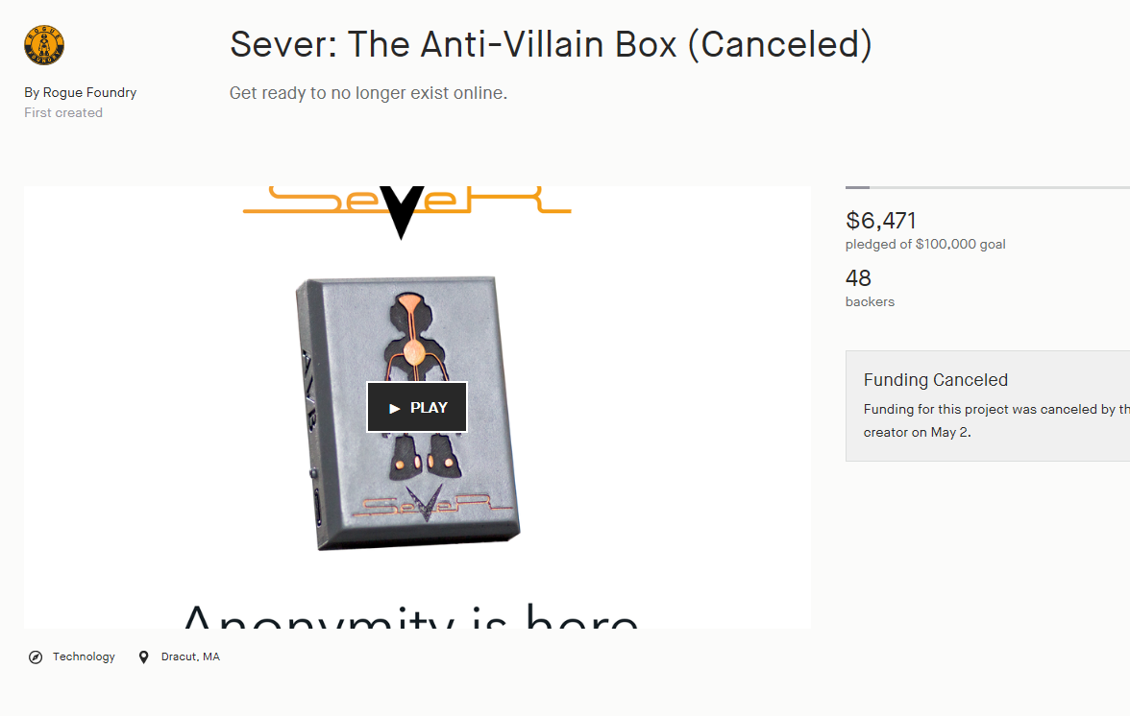
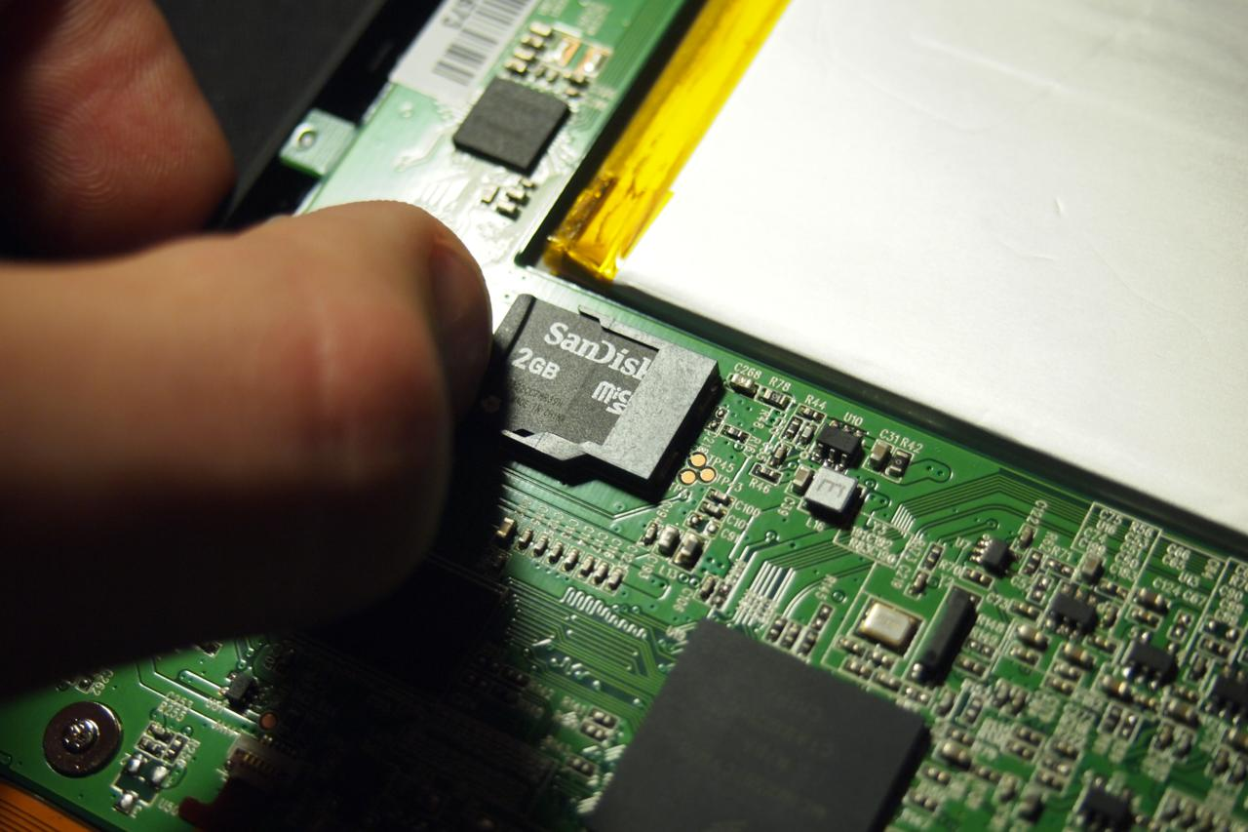
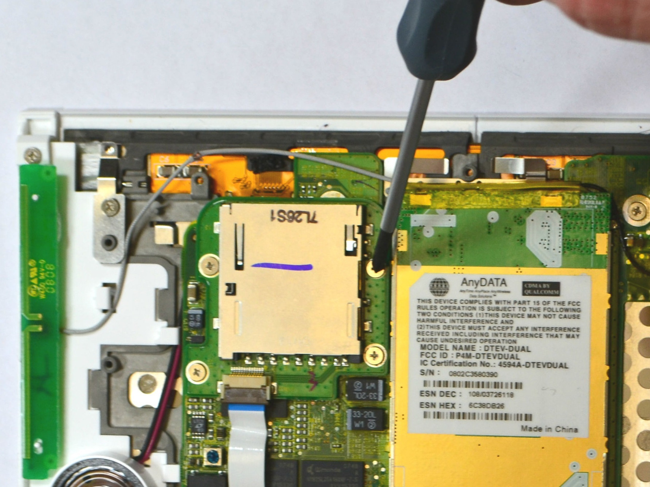
Surprise Mode: Direct Extraction
Could be as simple as “remove SD card, image it”
Notes:
But the number of devices that have these is astoundingly large. These are all devices, a game console, an “anonymity device” a first generation Kindle and a Kobo H2O. Many of these devices are just a Raspberry Pi with some added hardware on top.

Slide 50
Surprise Mode: Direct Extraction
Could be as simple as “remove SD card, image it”
eMMC is harder though, since you need to get to the data lines, but it can be done!
You will need to understand how the disk is laid out
Binwalk can help later, as can “standard” DOS partition tables.
Having some in-vivo information is helpful
Notes:
eMMC devices make things harder though. eMMC is really similar to SD in that they share a common ancestor, there’s a few divergences that have been made to make the phone manufacturing industry happy.

Slide 51
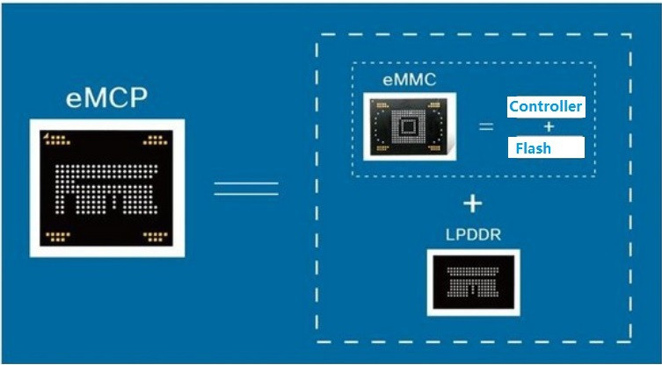
Surprise Mode: Direct Extraction
Could be as simple as “remove SD card, image it”
eMMC is harder though, since you need to get to the data lines, but it can be done!
You will need to understand how the disk is laid out
Binwalk can help later, as can “standard” DOS partition tables.
Having some in-vivo information is helpful
Notes:
More eMMC modules now are actually eMCP modules, where you have the eMMC module stacked in silicon alongside LPDDR.

Slide 52
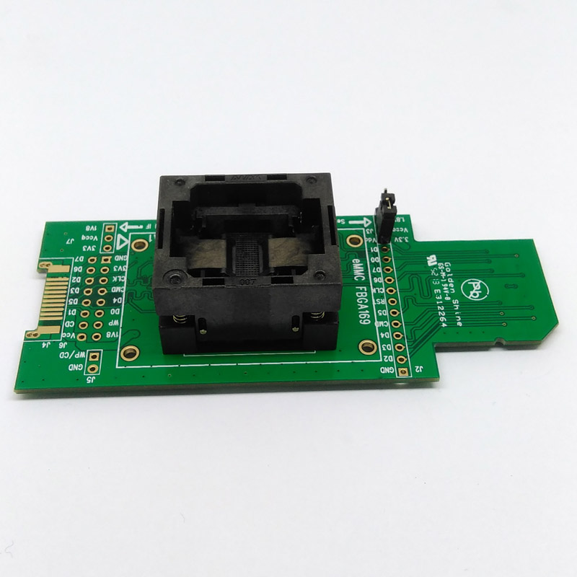
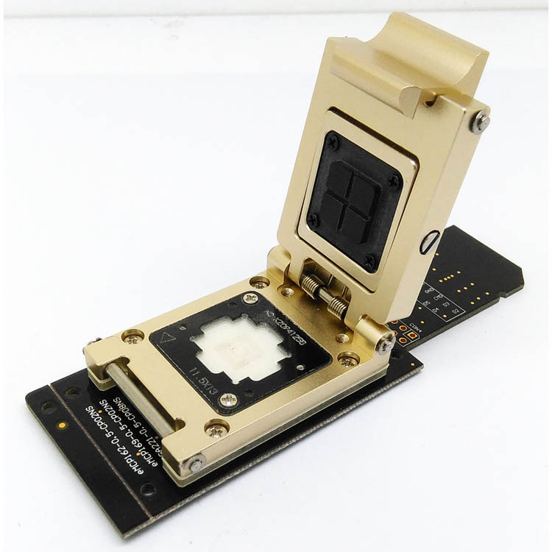
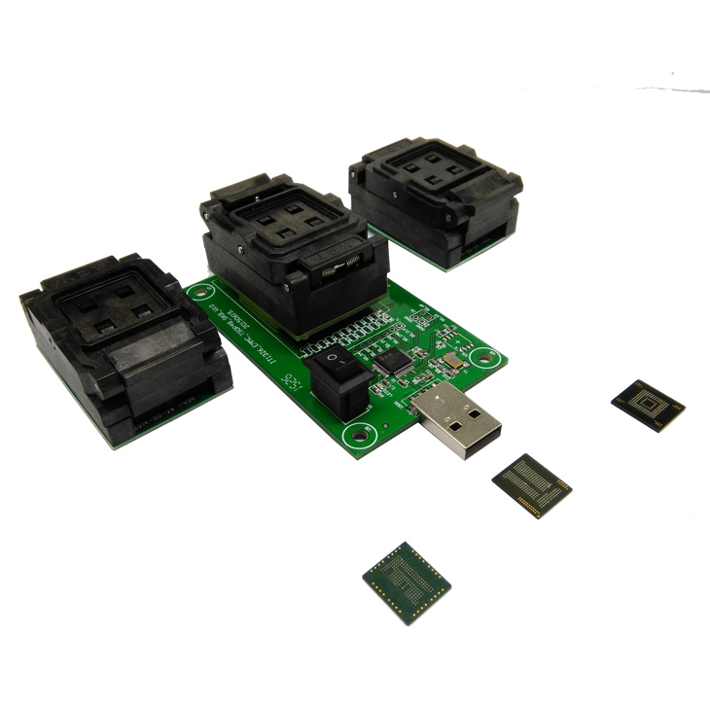
Surprise Mode: Direct Extraction
Could be as simple as “remove SD card, image it”
eMMC is harder though, since you need to get to the data lines, but it can be done!
You will need to understand how the disk is laid out
Binwalk can help later, as can “standard” DOS partition tables.
Having some in-vivo information is helpful
Notes:
eMMC readers are readily available. They come in all shapes and sizes and even have USB versions. eMMC cards still talk the same protocol that MMC cards talk, and are thus compatible with SD cards!

Slide 53
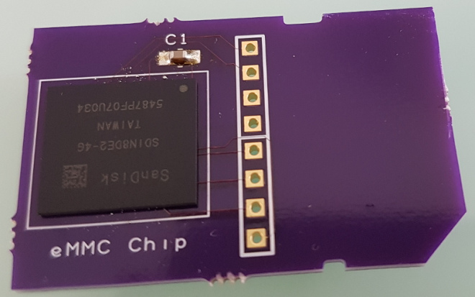
Surprise Mode: Direct Extraction
Could be as simple as “remove SD card, image it”
eMMC is harder though, since you need to get to the data lines, but it can be done!
You will need to understand how the disk is laid out
Binwalk can help later, as can “standard” DOS partition tables.
Having some in-vivo information is helpful
http://blog.oshpark.com/2017/02/23/retro-cpc-dongle/
Notes:
This also means you can be like this crazy bastard and make your own SD card adapters for eMMC devices.

Slide 54
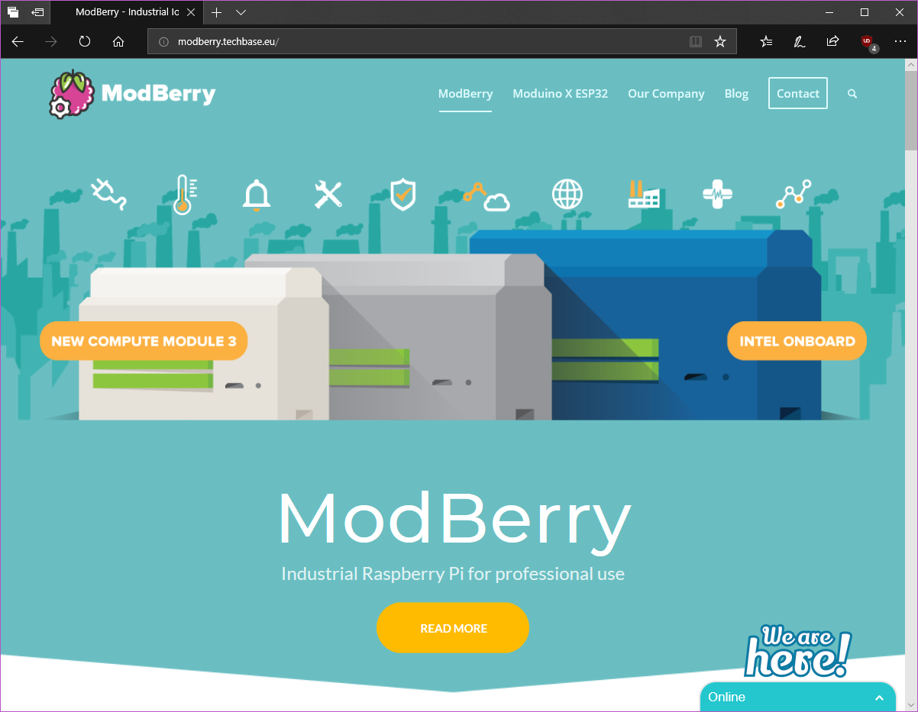
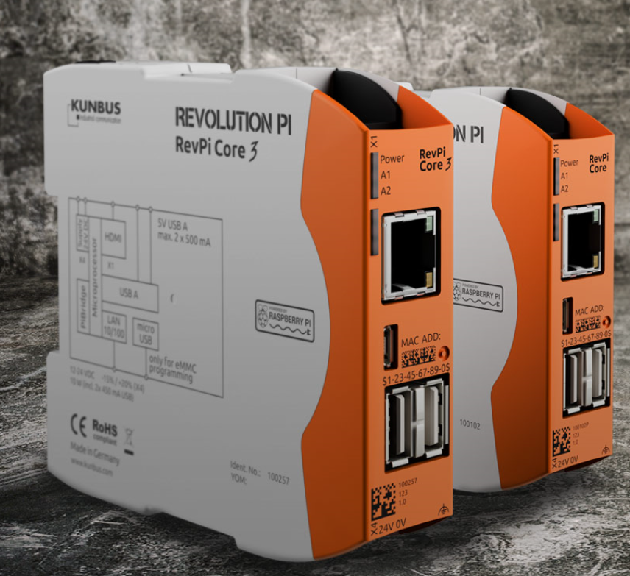
Surprise Mode: Direct Extraction
Could be as simple as “remove SD card, image it”
eMMC is harder though, since you need to get to the data lines, but it can be done!
You will need to understand how the disk is laid out
Binwalk can help later, as can “standard” DOS partition tables.
Having some in-vivo information is helpful
Notes:
eMMC devices are also more common in industrial applications, as their lack of a physical interconnect means they can be potted and conformal coated. They survive higher temperatures, more reads and writes than your typical consumer SD card, and are generally meant for more abuse.
These devices here are just two examples of Raspberry Pi clones – compatible ones, even – which are built around eMMC devices.

Slide 55
Surprise Mode: Direct Extraction
Could be as simple as “remove SD card, image it”
eMMC is harder though, since you need to get to the data lines, but it can be done!
You will need to understand how the disk is laid out
Binwalk can help later, as can “standard” DOS partition tables.
Having some in-vivo information is helpful
All Else Fails: Solder to the rescue
Might need to desolder some storage, or otherwise physically attack the hardware
MTD devices are weird. Prepare to get your hands dirty
Interested in more? HHV and friends are the place to start looking.
JTAG, etc. might be the hard way out.
Notes:
In the end, you may have to go out of your way and start sniffing around the device to try and find what’s going on. Your device might need a whole bunch of fun.
If you think this could be you, It’s time to go to the Hardware Hacking Village and learn you a Thing. Hardware is a whole different special chunk of fun that we won’t get into because that rabbit hole is deeper than some young men at a street fair in late September.

Slide 56
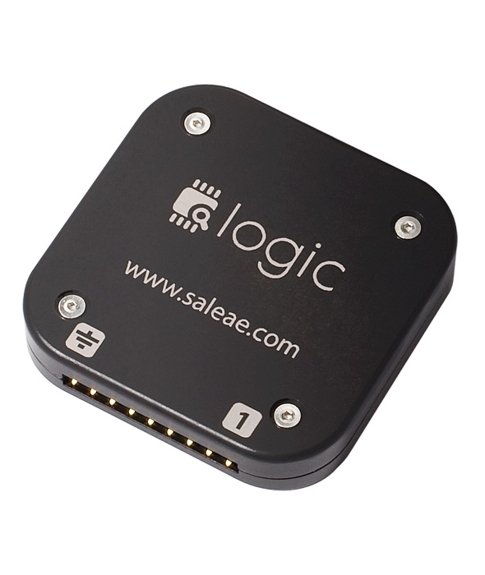
Logic Analyzers
Salae makes a good one
Cheap
Basic
Runs over USB
Notes:
It might be time to get a logic analyzer. There’s plenty of cheaper, USB based ones that are more than capable .

Slide 57
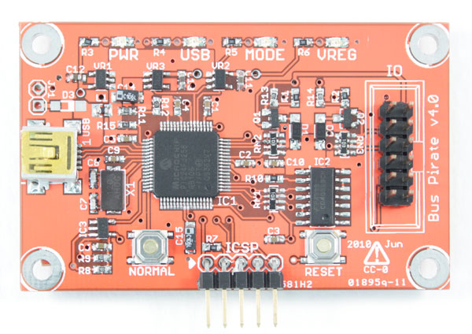
Hardware interfaces
http://dangerousprototypes.com/docs/Bus_Pirate
https://www.crowdsupply.com/excamera/spidriver
Notes:
Devices like the Bus Pirate and SPIDriver are convenient hardware bridges for the wide, wide world of hardware peripherals that let you bridge the gap. Sure, laptops have SPI and I2C but they’re not easily accessible as a platform. These sorts of devices are amazing ways for you to mumble with hardware.

Slide 58
Now that we have that, what do?
Try mounting it/extracting it/etc. `file` might give you a good idea of what it thinks it might be, as will `strings` and the like.
eMMCs sometimes have real partition tables
SD cards often do
Look at the reconnaissance you did
Boot logs: lots of good information about partitions
Fstab, /proc/mounts
Notes:
So now we have the root filesystem, or a dump. It’s time to start digging around.

Slide 59
Let automation do your work
Binwalk!
Takes a rough guess at what might be in a place
Makes educated guesses about filesystems
High false positive rate
Photorec might be helpful
Get creative
Losetup and friends are capable of more than you give them credit for.
There are a lot of filesystems that are read-only or create-and-read, like cramfs and such. These are often spotted by binwalk but are even sometimes seen as lzma or other compressed or high-entropy data
If you’re only looking to play in IDA/Radare/etc, the bulk extraction from binwalk might help.
Notes:
The biggest thing that you should get in the habit of is finding automation tools that work for your use case. Binwalk is the classic tool for this. It makes rough, educated guesses and spits out more guesses. It has a fairly high false positive rate, but a fairly low false negative rate, which makes it fairly useful in finding what could be hiding under there, so long as you can dig through the dirt.
Tools like Photorec, losetup, etc. are sometimes useful in their own right: These sorts of tools have a little bit of smarts baked in that can be really helpful. There are compressed filsystems that binwalk will ignore that other tools will totally be happy to consume. Your worst case is that a tool makes your working directory a bit of a mess.

Slide 60
QEMU: the Quick EMUlator
QEMU is a fast processor emulator for a variety of targets.
Targets you’ve never heard of?
Mainframes
ARM, MIPS
PowerPC
OpenRISC
DEC Alpha
Lots of different ports and targets have been ported.
Notes:
However, this brings us to one amazing chunk of automation: QEMU. QEMU is a fast emulator for a variety of different platforms, letting you do stupid shit like

Slide 61
Did someone say “OSX on Amiga hardware”?
Notes:
Run Mac OSX 10.4 on an Amiga

Slide 62
Or Haiku on BeOS?
Notes:
Or run Haiku on BeOS.
Or, alternately, more practical things.

Slide 63
Two ways to run QEMU
As a full fat VM
As a translating loader
You preserve full control over the whole process
You’ve got access to things like gdb at a kernel level
Requires zero trust in the safety of the binary
But you probably want a special kernel and board setup, though there are generic setups to get you started
Any tools are going to need to be compiled for the target environment
I hate cross-compilers.
You have access to all your existing x86-64 tools (or whatever your native tools are)
They’re not only native, but they’re running full-speed.
You can run AFL like it’s meant to
Runs nicely in containers
You don’t even need a container!
Notes:
QEMU has two general modes: A full-fat VM, like we just saw, or as a translating loader in Linux. Your device turned out to be X86 but you’re a paranoid person and don’t feel like letting it touch the real hardware directly? Full fat VM. Hell, even PowerPC can get in on the game. As a loader, it makes those weird executables from that hot new device look like any other executable.

Slide 64
Full-Fat VM: 9 tracks of DOS
Notes:
Here we see QEMU running as a full VM, running MSDOS 6.22 and interfacing with real hardware, a gigantic Overland Data 9 track tape drive. I used this to dump Data General AOS boot and install tapes.

Slide 65
Binfmt: Linux’ way of loading executables
Long ago, Linux added loadable loaders
Originally for the purposes of running JARs from the command line like God and Sun Microsystems intended.
Turns out this is a great place to put emulators.
Debian ships with support for this in its binfmt-misc package.
QEMU can be shipped as a “static userspace” environment (think WINE)
Uses “magic numbers” – signatures from a database – to determine which ones are supposed to load what.
Fairly simple to add new kinds of binaries. You could actually execute JPEGs if you really wanted to?
Notes:
So let’s talk about Linux’s loader. Ever wondered why you can call Mono and WINE executables directly from the command line? Simple, it’s the loader framework. Originally so that you could call JARs directly, it’s now fairly trivial to add new kinds of “executables” to Linux.

Slide 66
QEMU as loader
Without a container
With a container
Dumb simple to set up:
qemu-whatever-static <binary>
With binfmt, just call your binary.
Must trust that the executable is not malicious
Might depend on your local environment looking like its target environment
This works best for static, monolithic executables
Bring that whole root filesystem along!
Run it in the confines of a jail, Docker instance, even something like Systemd containers
Might need root depending on your container (systemd)
Great for when your binary loads its own special versions of libraries that have weird things added to them
Notes:
As a loader, it comes down to two options: With or without containers. Without a container, you’re going in raw with no protection. If that executable decides to do something terrible to you, it’s totally going to do it. On the other hand, containers are a totally reasonable option. Using containers means that you have some amount of wall around a possibly malicious application, or something that needs weird library setups. As long as Linux can call the loader, it’s all fine.

Slide 67
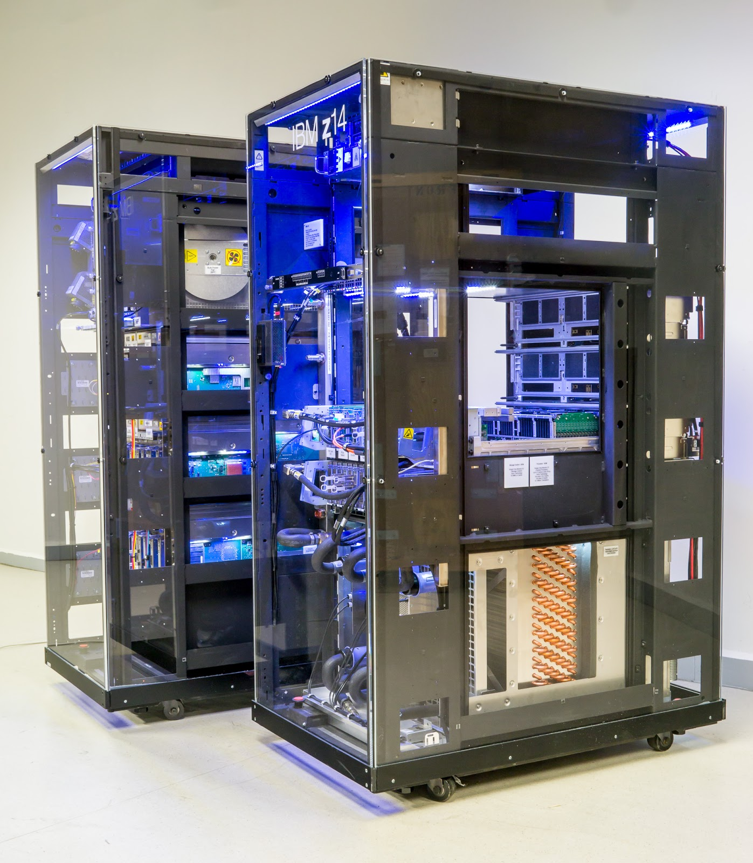
Notes:
To give you context on what you’re going to see next, this is the hardware most software expects. Not a laptop running a VM running QEMU.

Slide 68
QEMU user Demo
Notes:
Here we see QEMU running S390x executables from Alpine Linux, doing a full boot, then just running a shell from the ArmArch64

Slide 69
AFL setup
Oh boy. Let’s talk about AFL.
AFL needs to compiled with QEMU support
Magic sauce: CPU_TARGET=whatever ./build_qemu_support.sh
AFL needs to bring along the host’s libraries
Easiest bound with systemd-nspawn
Don’t do this in a VM
It hurts
Notes:
In my outline, I promised a demo of AFL.
AFL needs a bunch of setup. I had to compile AFL under Debian, pull over a bunch of libraries from the local side, then pass in some environment arguments. Why am I going to these great lengths? I’m running it into the container that all the s390x executable lives in, which is under Alpine’s version of musl libc.

Slide 70
AFL Demo

Slide 71
Wrapping up
What did we learn today?
Hardware vendors are lazy
Attacking hardware means getting creative
QEMU is pretty neato
AFL runs really slow when you’re emulating an X86 emulating an IBM mainframe.
Going forward:
I hope I’ve given you some idea of the landscape of tools
Always remember rule 0

Slide 72
More Resources
Non-Linux targets:
RECON 2010 with Igor Skochinsky: Reverse Engineering for PC Reversers: http://hexblog.com/files/recon%202010%20Skochinsky.pdf
JTAG Explained: https://blog.senr.io/blog/jtag-explained
https://www.blackhat.com/presentations/bh-europe-04/bh-eu-04-dehaas/bh-eu-04-dehaas.pdf
https://beckus.github.io/qemu_stm32/ (among others)
Linux targets:
eLinux.org – Fucking Gigantic wiki about embedded Linux.
linux-mips.org – Linux on MIPS

Slide 73
Thank you
Keep on hacking.

